Slide 1
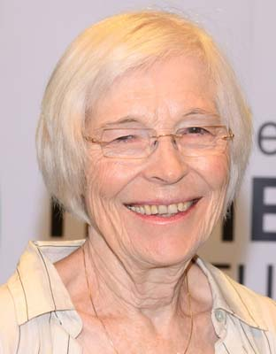
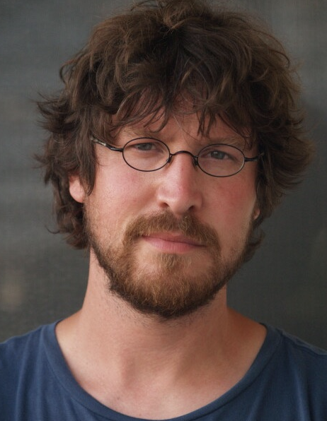
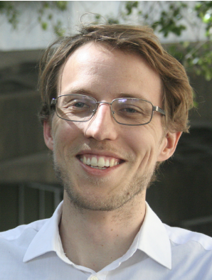
Predictive representations in vision and language
Jiaming Xu

Slide 2
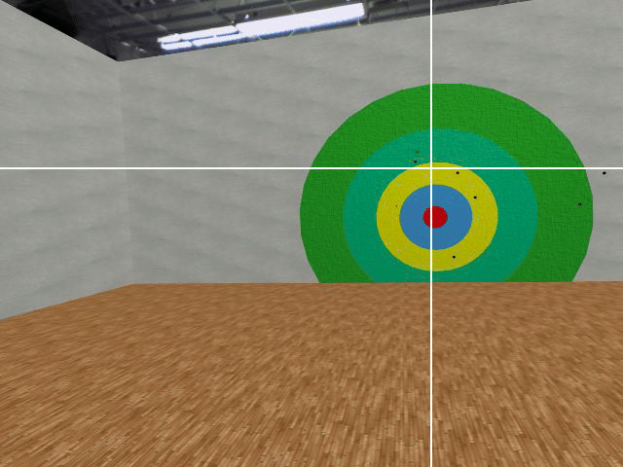
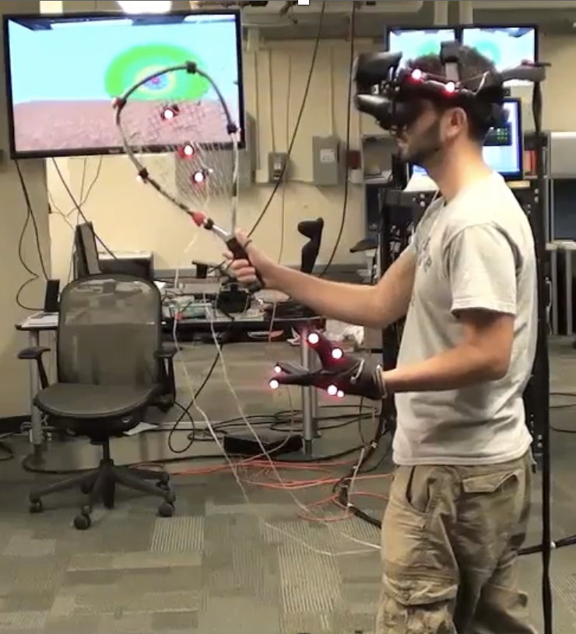
Predictive saccades
when playing virtual
racquetball
Notes:
We make predictions all the time.
To interact with the environment, and with other people, we need to be able to convert the recent inputs into reasonable predictions of future states.
To hit the ball, this man is making predictive saccades to where the ball will likely end up in the next second
We do this rather effortlessly, might not even realize

Slide 3
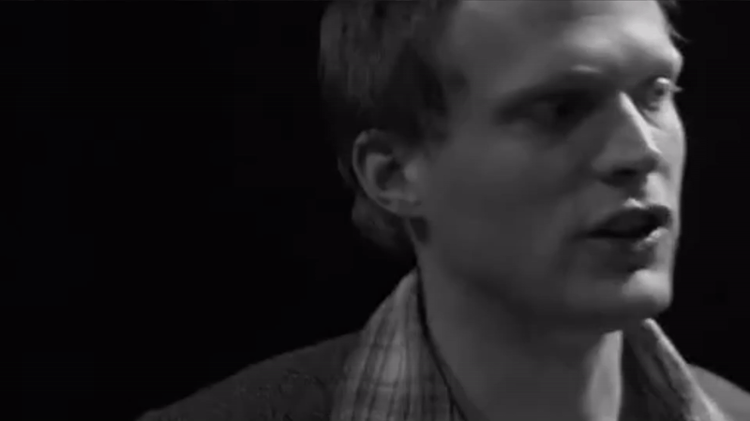
What are the mechanisms underlying prediction?
Notes:
But if you look at the input level, its not obvious how our brain does this.
I’m interested in…

Slide 4
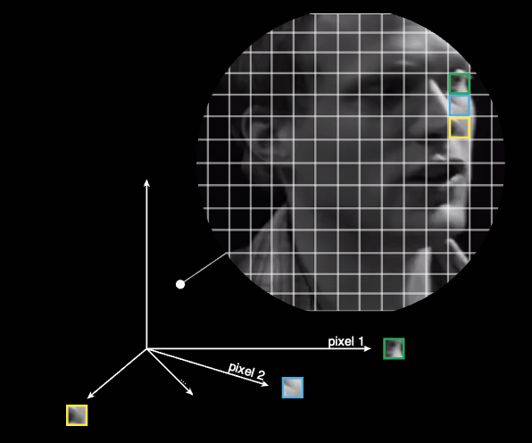
Pixel intensity
Notes:
The information we are dealing with is light intensities at each pixel. Let’s represent this entire frame as one point in this high dimensional space, each dimension is the intensity of one pixel

Slide 5


Temporal straightening hypothesis
Define curvature in pixel space:
Hénaff, O. J., Goris, R. L., & Simoncelli, E. P. (2019). Perceptual straightening of natural videos. Nature Neuroscience.
Notes:
Now let’s consider a movie, with the added time dimension, the points start to trace out a trajectory. At the input level, we observe these trajectories to be highly curved and irregular. What that means is that it is really difficult to predict where the next point is going to land in this space. The temporal straightening hypothesis suggests that our visual system transforms the representations of recent input to follow a straighter trajectory, which facilitates linear extrapolation.
Curvature is defined as deviations from a straight path

Slide 6
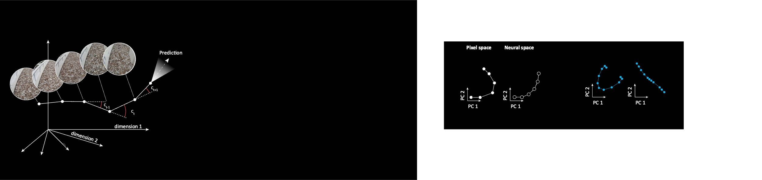
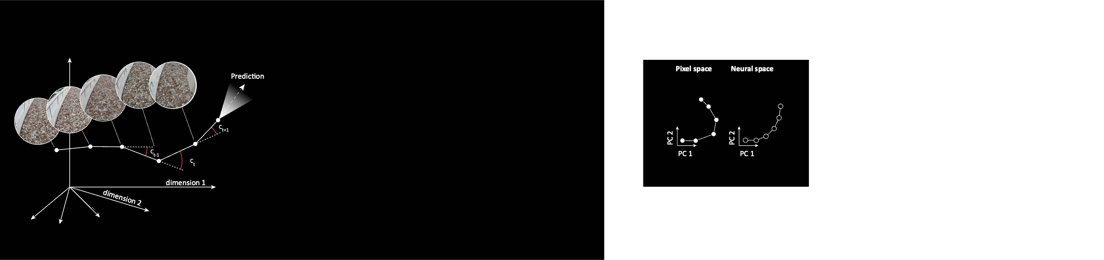
Temporal straightening hypothesis
Evidence from behavioral psychophysics
(Hénaff et al., 2019)
Pixel space
Perceptual space
Evidence from electrophysiological recordings
in Macaque V1 (Hénaff et al., 2021)
Pixel space
Neural space

Slide 7
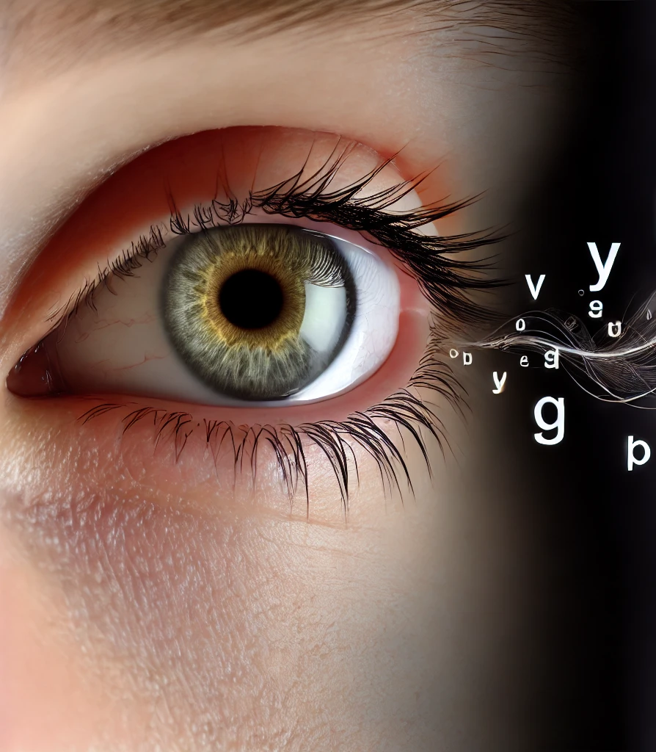
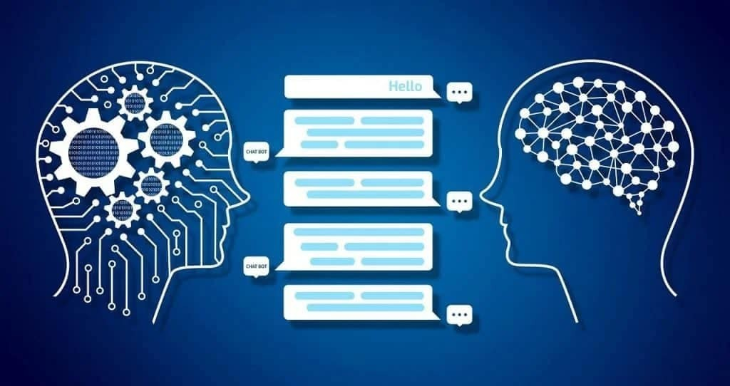
Temporal straightening as a general predictive mechanism across domains?
Notes:
These insights might be applied beyond vision
Language is a domain where information unfolds over time, and where prediction is a natural objective function.

Slide 8
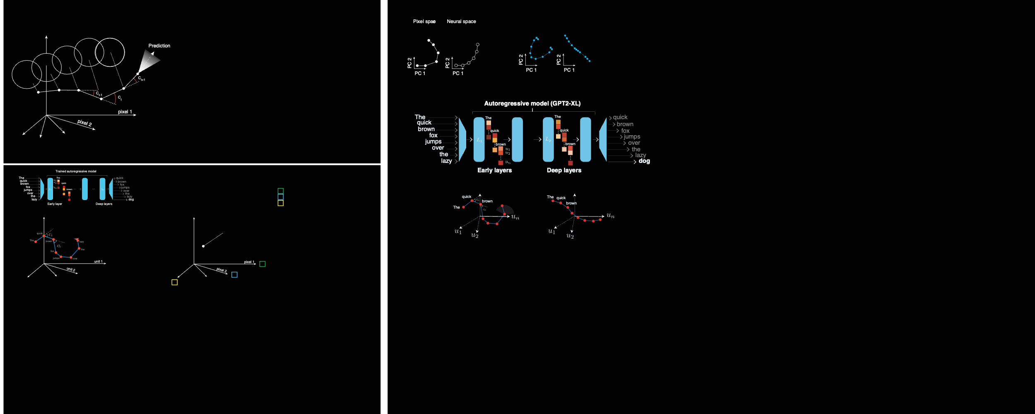
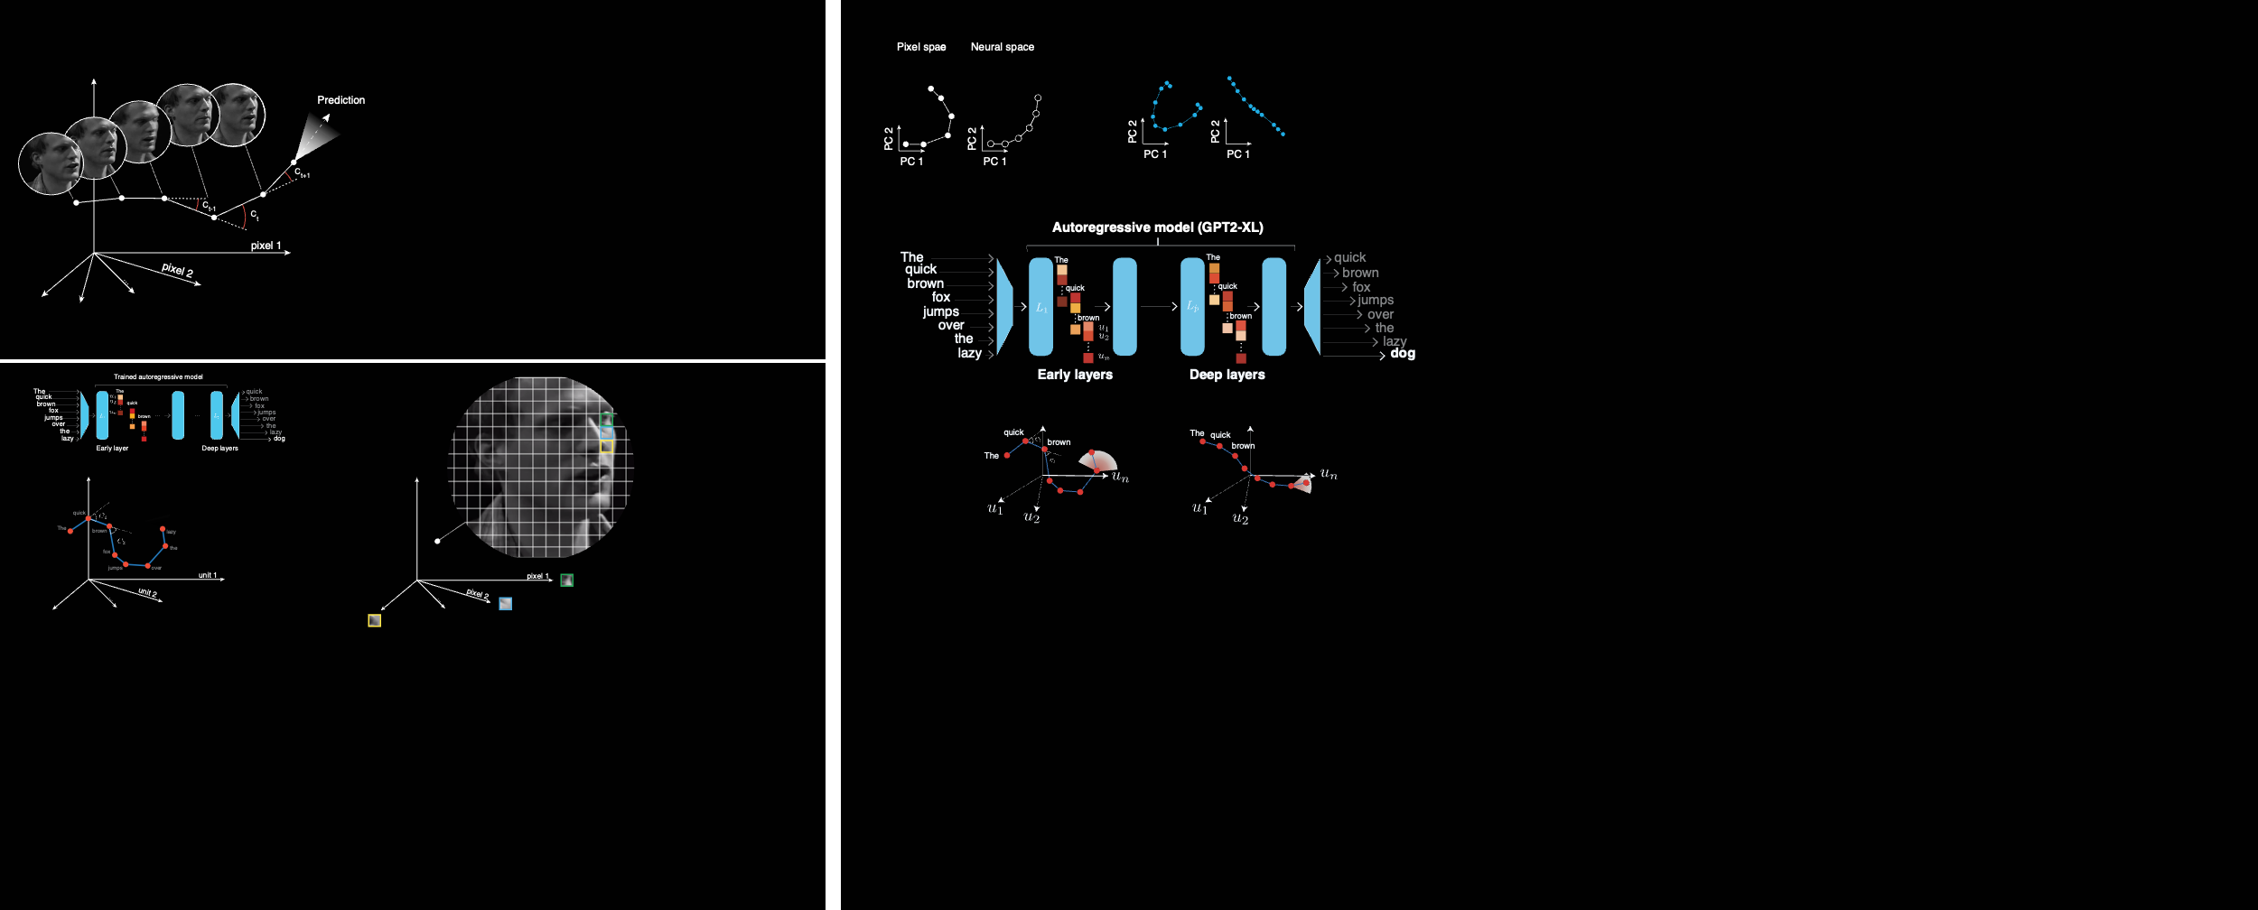
Hosseini, E. A., & Fedorenko, E. (2023)
Notes:
Recently, Hosseini and Fedorenko tested the temporal straightening hypothesis in autoregressive transformer models.
You pass a sentence through the network, in each layer, you can get activation weights of all the units for each word (represented as one point in this space) and then calculate the average curvature of a sentence trajectory
too complex to be unpacked in one single computational step. So they compare earlier layers with deeper layers
The early layers of the model approximate the early stage of processing in the brain, which deals with acoustic and word information at the sub-second scales, whereas, later layers approximate later stages of processing, where information is combined over many seconds to derive meaning
So they hypothesized that the trajectory would become progressively straighter in deeper layers to facilitate prediction. And that’s what they found.

Slide 9
Activation weights
Sentence curvature in layer P:
Hosseini, E. A., & Fedorenko, E. (2023)
Notes:
Consider Lp activation as states x1, x2,…, xn

Slide 10
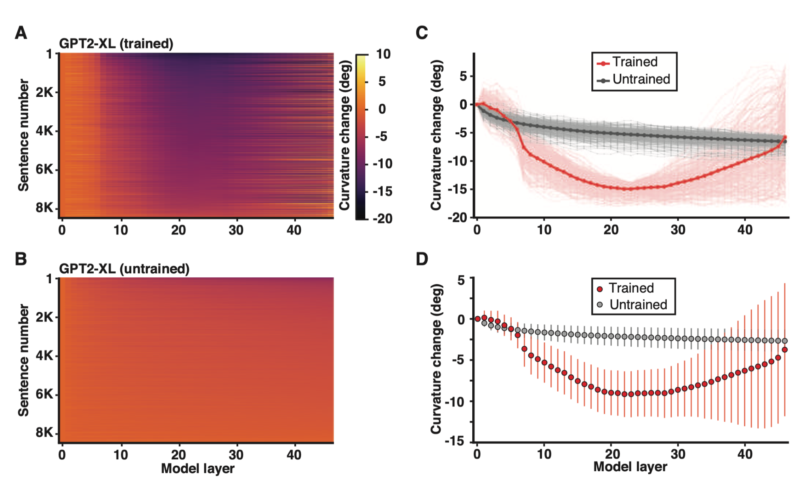
Hosseini, E. A., & Fedorenko, E. (2023)
Notes:
In Figure 2A, we plot for each layer (column), the difference in curvature relative to the curvature in the first layer for each sentence (row).
Beyond the middle layers, where we see a reduction in curvature for all sentences, the curvature trajectories are somewhat variable across
sentences: for some sentences, the curvature remains relatively constant from the middle to the late layers, for others, it increases towards the values in the early layers. The increase in curvature (on average) in the later layers is plausibly due to the fact that the model needs to eventually map its
representations back to words in the output, and the word space is inherently nonlinear.
B. to make sure change in curvature is not due to model architecture
C. selected 300 sentences with the max curvature drop for the trained and untrained model

Slide 11
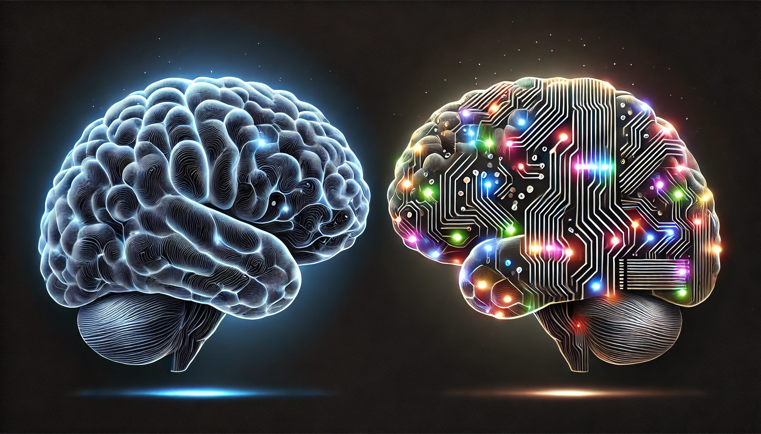
How about humans?
(ChatGPT, 2024)
Notes:
We are really excited about these findings because
Suggest that temporal straightening can be applied across two different domains
Opens up exciting questions - what about humans? If we share the same predictive mechanism can we begin to understand why chatGPT is so good?

Slide 12
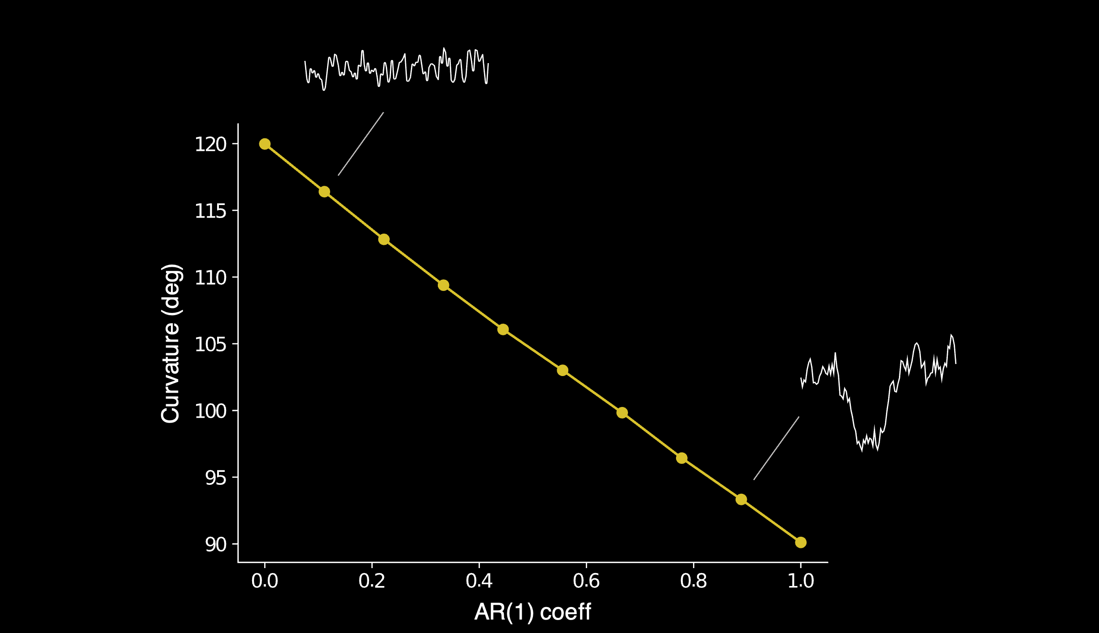
How do we test this?
Longer timescale
Straighter trajectory
Prediction:
Representations of language trajectories become progressively straighter (longer timescale) along the language processing hierarchy
Short timescale
Long timescale
Notes:
fMRI data is too noisy to provide reliable curvature estimates
But it is great for estimating timescale information
We hypothesized that there’s a relationship between curvature and timescale
So we simulated time series with different timescales using a first-order autoregressive model, these are some examples, and we calculated curvature
And we found there’s a strong relationship.

Slide 13
Fitting AR(1) to data

Slide 14
Coherence

Slide 15
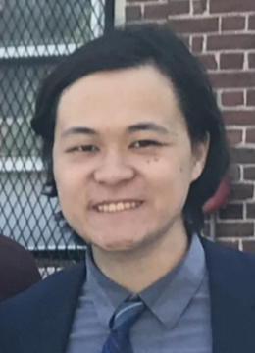
(data collected by Jerry Tang)
Notes:
This is fMRI data collected by Jerry while subjects listened to continuous stories in the scanner.
To estimate the timescale of fMRI signals, we look at power spectral density -- how the power of BOLD signals is distributed across different frequency bands
If most of the power is concentrated in low-frequency bands, the signals reflect longer timescale processes
superior premotor ventral (SPMV) – low level speech processing/motor area, this is lower level, will behave more like AC than prefrontal

Slide 16
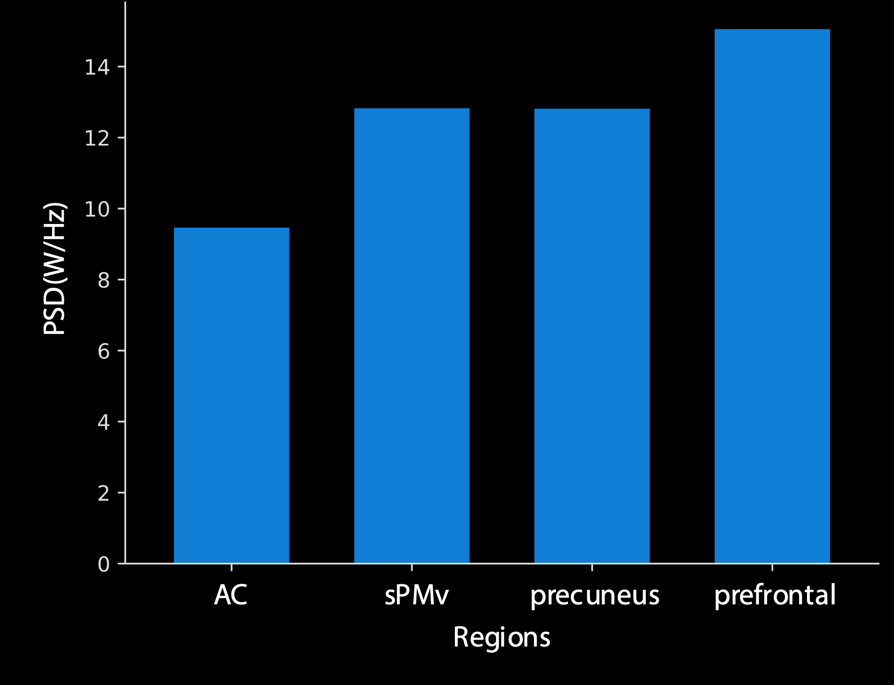

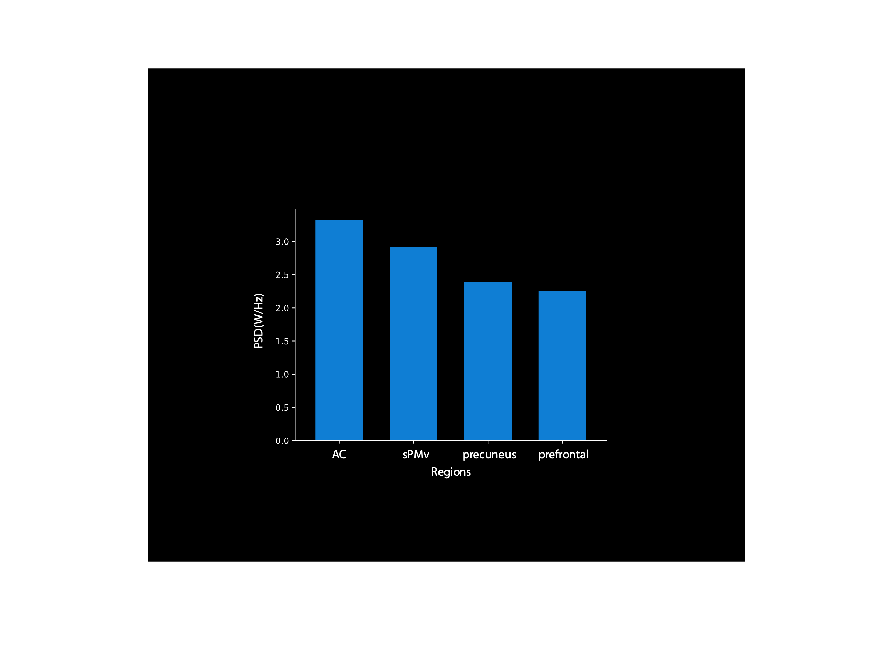
Freq. = 0.01
(long timescale)
Representations of language trajectories become progressively straighter (longer timescale) along the language processing hierarchy
Next steps:
Prove this relationship mathematically
Look at vision data. Does visual trajectories become straighter along the visual hierarchy?
Freq. = 0.12
(short timescale)

Slide 17
Thank you!

Slide 18
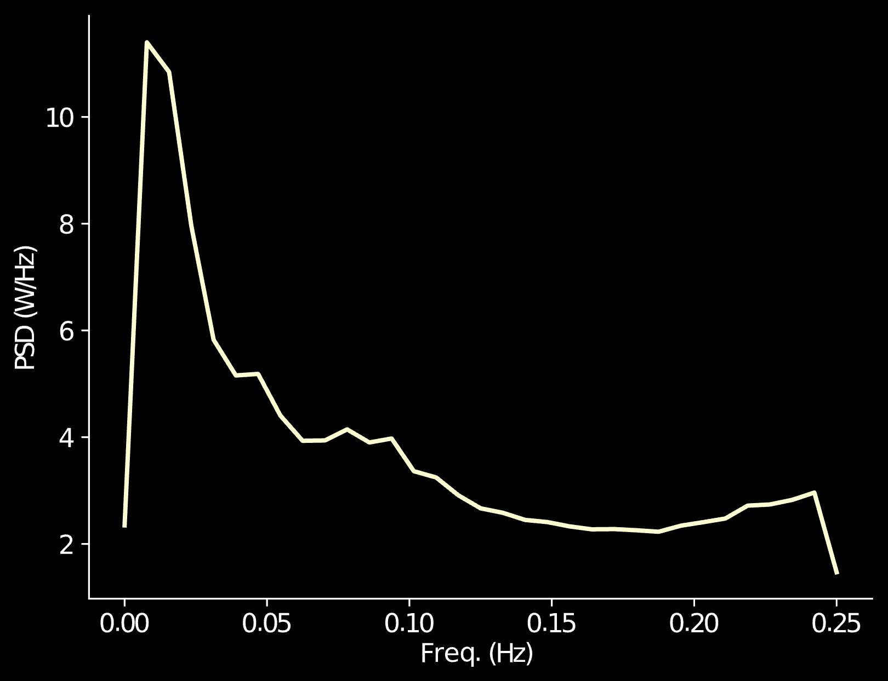
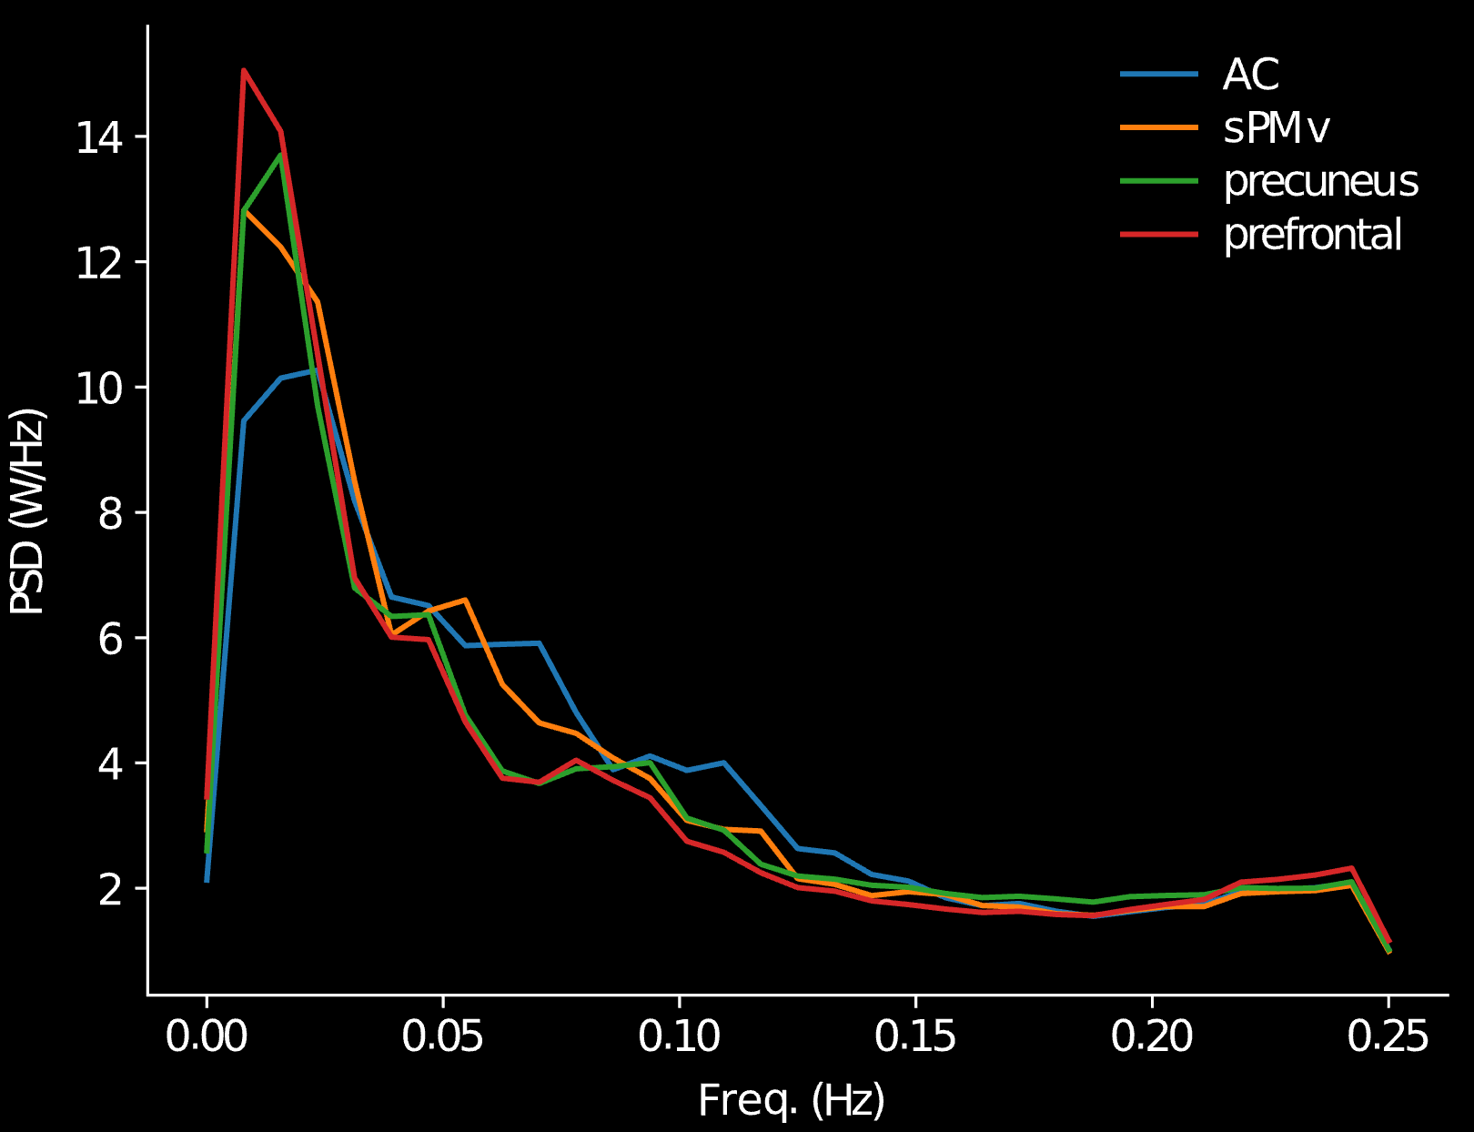
Results

